Slide 1
CAR Administration Overview
Module 5 – Accepting Implementation

Slide 2
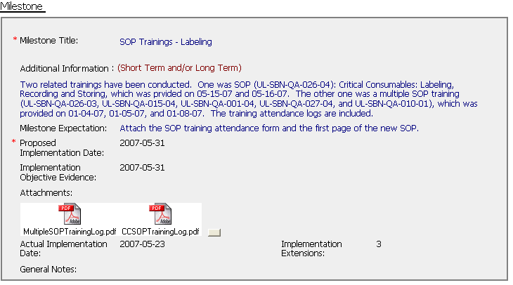
Implementation Evidence
Purpose – Provides evidence that each activity listed in the milestone has been completed

Slide 3
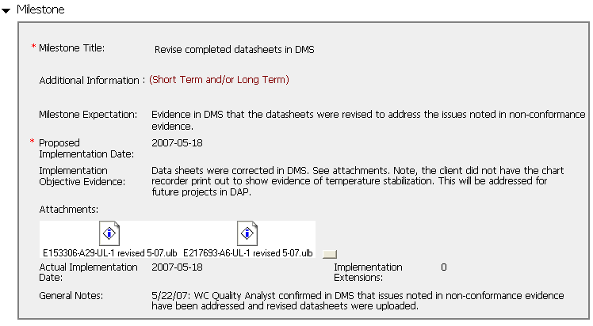
Implementation Evidence
Short meaningful title
Expectation that describes exactly what is needed to close the milestone
Description of what is provided as Objective Evidence
Specific evidence as attachments
Additional notes to clarify the evidence provided

Slide 4
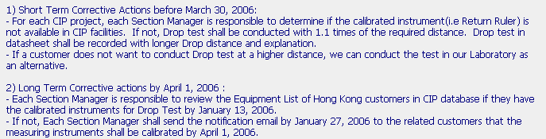
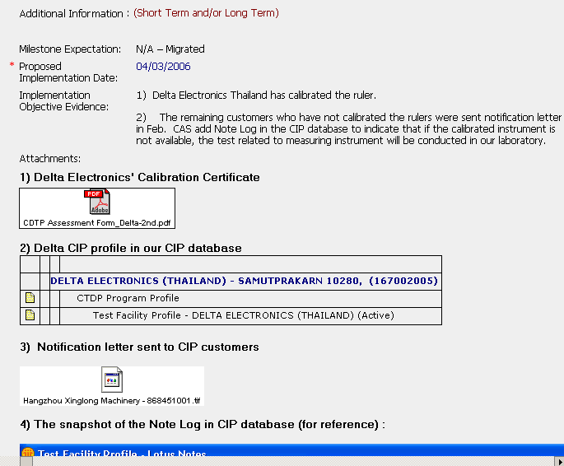
Example: Implementation Evidence
Item #1 Plan
Item #2 Plan
Item #1 Evidence Text
Item #2 Evidence Text
Item #1 Evidence Attached
Item #2 Evidence Attached
Proof that they “did what they said they were going to do”

Slide 5
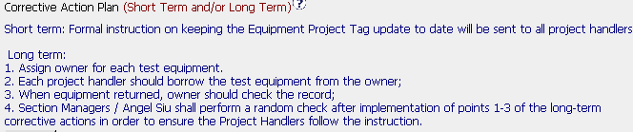
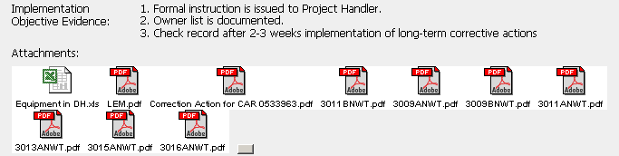
Example: Implementation Evidence
Every item has corresponding evidence of completion

Slide 6


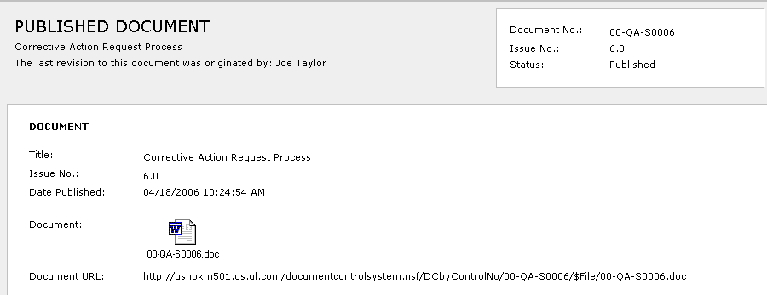
Example: Document Reference
GOOD EXAMPLE
Not the correct reference . . .
. . . use this instead from the document container

Slide 7
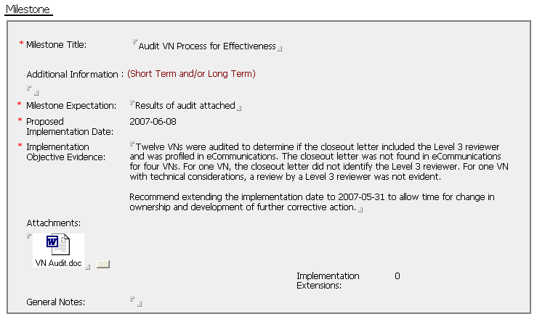
Good Practice –
Verification by CAR Owner
This is a situation where the CAR Owner performed audit and found that their solution was not adequate.

Slide 8
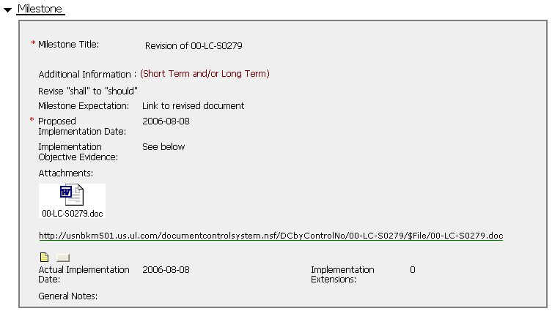
Review this Implementation

Slide 9
Review this Implementation
GOOD: Short meaningful title
GOOD: Evidence provides the URL link to the document plus an attachment showing the changes
MISSING – Details of what modifications were expected to be made to this document.

Slide 10
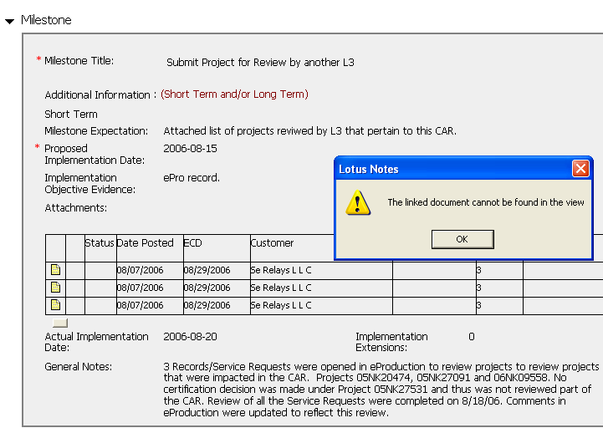
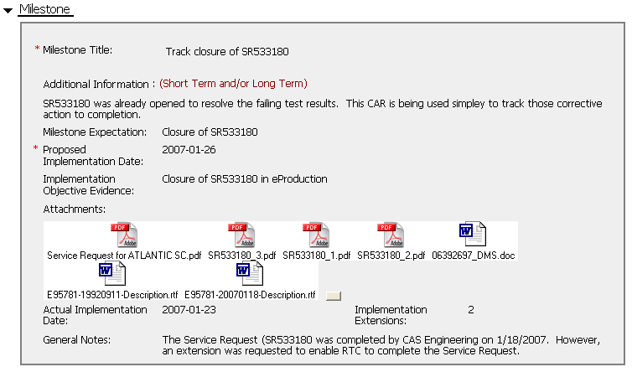
Avoid links to Notes Documents:
Emails, ePro, eComm, etc.
Notes Links can break – For example, ePro Service requests are purged regularly
Better practice – Provide PDF or Word links to the information as Objective Evidence

Slide 11
Implementation Summary
Evidence of completion for all items of the corrective action plan
URL link to the released documentation as well as an attached copy
PDF files and photographs should be attached as appropriate (IECEE requires this for corrective actions involving calibration certificates and equipment issues)
Beware of voluminous information and excessive unrelated/unneeded attachments
Do not submit plans that are not yet completed

Slide 12
End of Module 5
Revision 1.0 – Version presented to EULA team June 2007, complies with 00-QA-S0010 Issue 6.0 and 00-QA-J0029 Issue 1.0.

